Slide 1
Vulnerability Detection in
Mobile Applications using
State Machine Modeling
Wesley van der Lee
Cyber Security Colloquium
December 5th, 2017

Slide 2
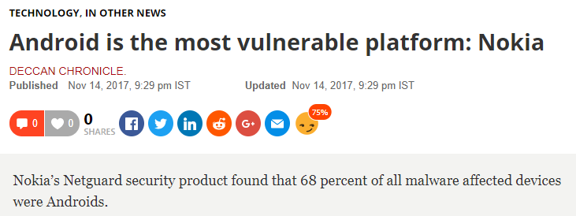


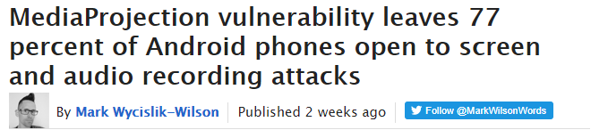
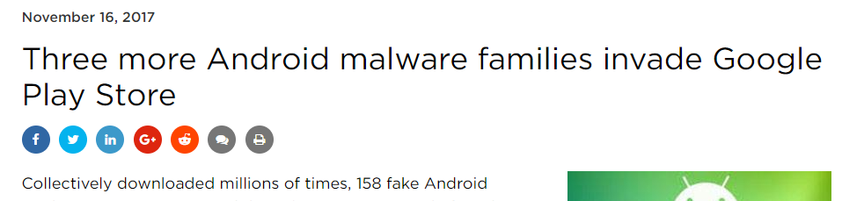
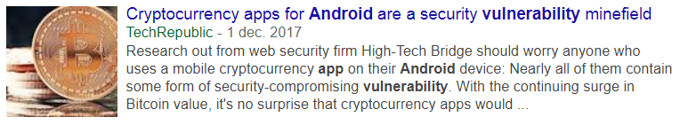
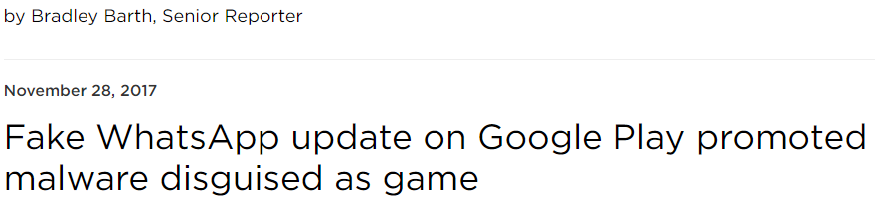
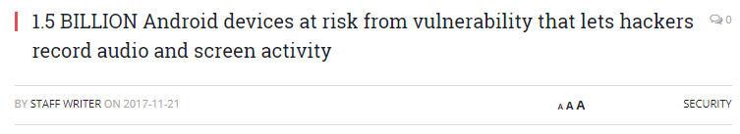






Introduction
>
>
>
1. Introdction
Notes:
https://medium.com/master-of-code-global/app-store-vs-google-play-stores-in-numbers-fd5ba020c195
Android: Google Play Store: 2.7M
Apple: App Store: 2.2M
Windows Phone Store: 300K
BlackBerry World: 130K

Slide 3



Research Goal
1. Introdction
Notes:
Current testing tools:
No insight
Not automatic enough -> Requires Manual Research
New testing technique with new insights is the area of state machine testing

Slide 4
Outline
State Machine Learning
Mobile Applications
Results
Conclusion
1. Introdction

Slide 5
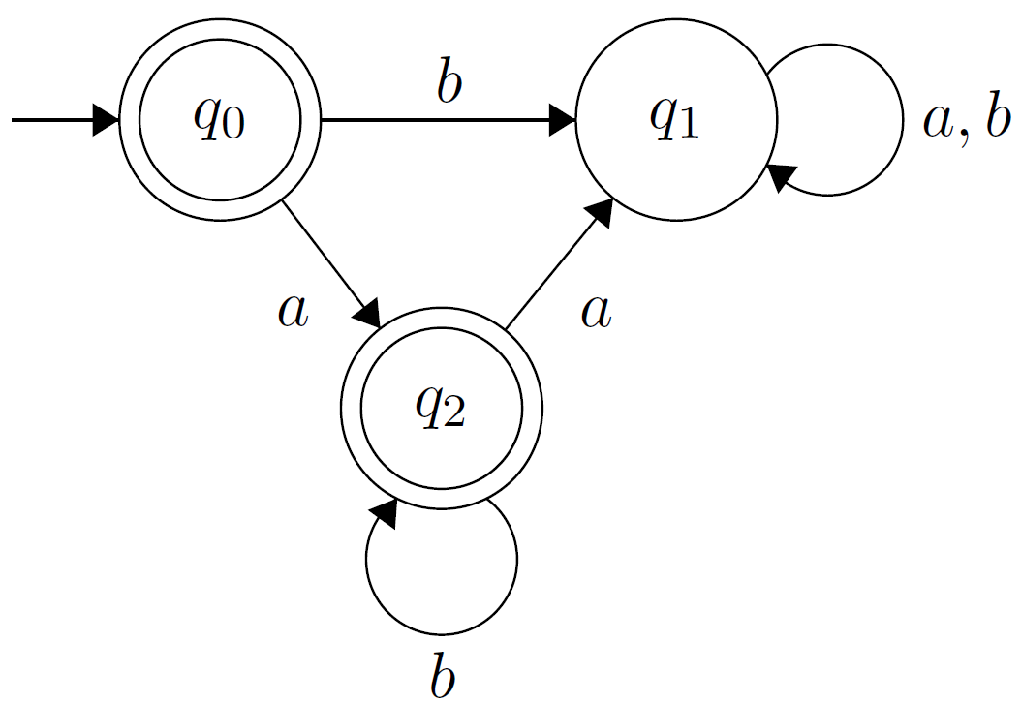
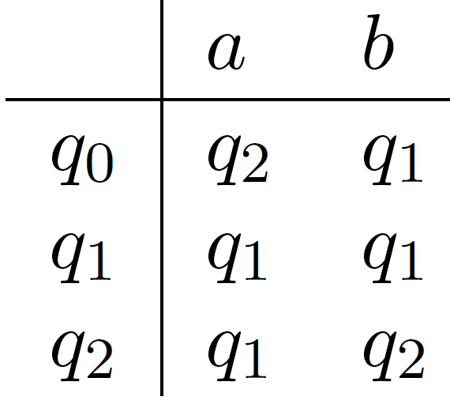
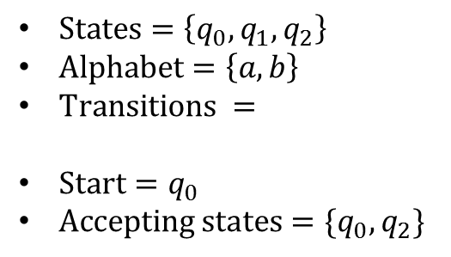
Definition of a State Machine
$States=\left\{q_{0},q_{1},q_{2}\right\}$
$Alphabet=\left\{a,b\right\}$
$Transitions =$
$Start=q_{0}$
$Accepting states=\{q_{0},q_{2}\}$
2. State Machine Learning

Slide 6


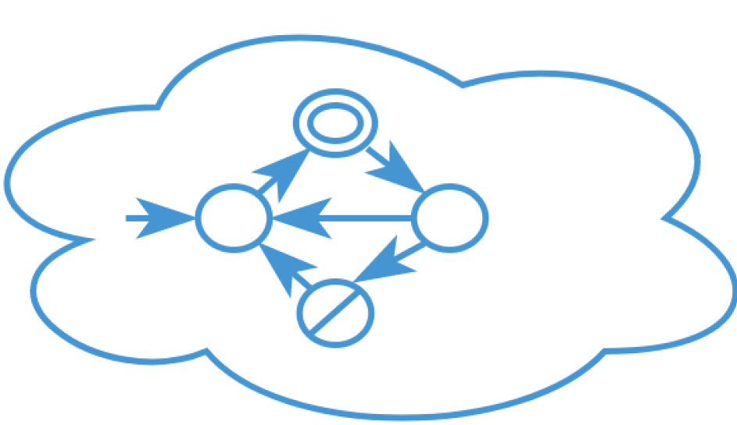
MAT Framework
Minimally Adequate Teacher (Angluin, 1988)
Membership Query(input)
simulation(input)
System
output
output
Membership Queries
Equivalence Queries
Yes: done
No: Counterexample
Equivalence
Query
2. State Machine Learning
Angluin, Dana. "Queries and concept learning." Machine learning 2.4 (1988): 319-342.

Slide 7

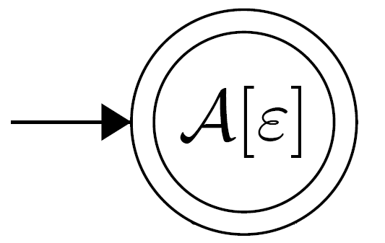
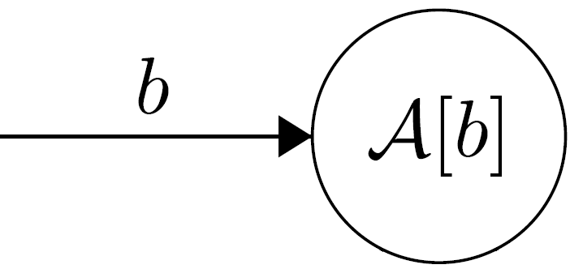
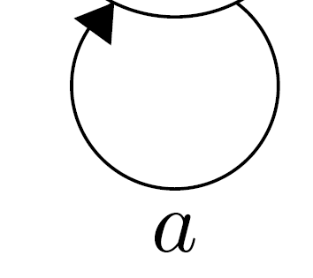
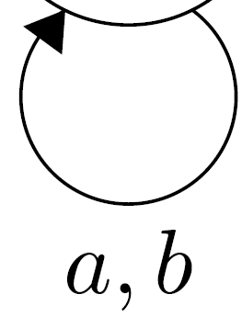





Active Learning with L*
$S$=
Prefixes (row)
$$A$$
$E$=
Suffixes (column)
 | ε
ε
b
a
$$H_{1}$$
ba | 0
bb | 0
 | 1
 | 0
 | 1
Observation
Table:
$$Alphabet=\left\{a,b\right\}$$
Rows:
Unique rows: identify states
2. State Machine Learning

Slide 8
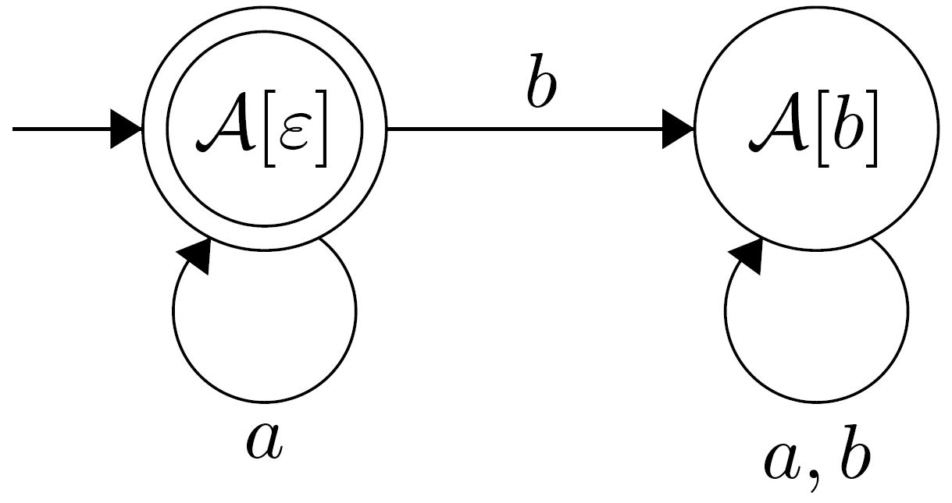
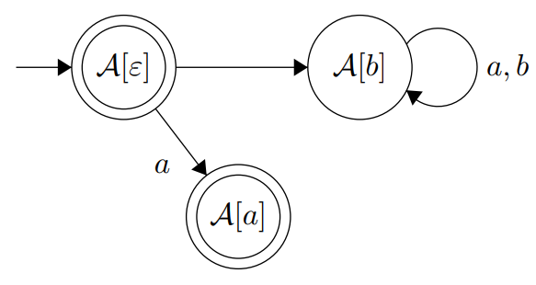
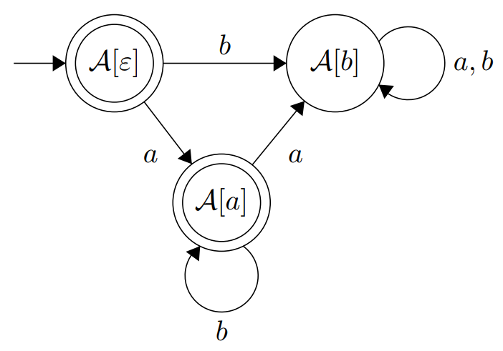


Active Learning with L*
YES: EQUIVALENT!
Equivalence Query
NO! Counterexample: ab
$$A$$
$$H_{1}$$
aa | 0 | 0
bb | 1 | 1
 | ε | b
ε | 1 | 0
b | 0 | 0
a | 1 | 1
ba | 0 | 0
bb | 0 | 0
$$H_{2}$$
Isberner, Malte, Falk Howar, and Bernhard Steffen. "The TTT Algorithm: A Redundancy-Free Approach to Active Automata Learning." RV. 2014.
2. State Machine Learning
Notes:
Value 0 in ε-column sufficient to distinguish [b] from other two states

Slide 9
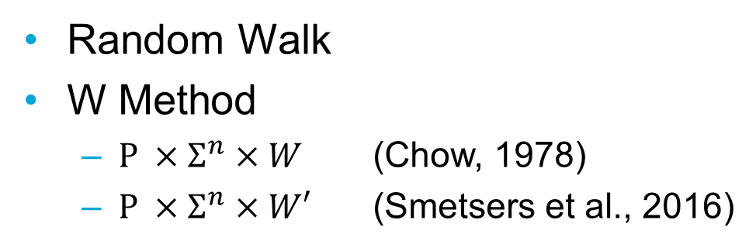
Equivalence Queries
$$A$$
Random Walk
W Method
$P ×Σ^{n}×W$ (Chow, 1978)
$P ×Σ^{n}×W′$ (Smetsers et al., 2016)
Chow, Tsun S. "Testing software design modeled by finite-state machines." IEEE transactions on software engineering 3 (1978): 178-187.
Smetsers, R. et al. "Minimal separating sequences for all pairs of states." International Conference on Language and Automata Theory and Applications. Springer International Publishing, 2016.
2. State Machine Learning

Slide 10




Mobile State Machine Learning
$$w$$
Appium command
$$w$$
command
1/0
Equivalence
OK/Error
1/0
OK/Crash
YES/Counterexample
Mapper
Appium
3. Mobile State Machine Learning

Slide 11
Mobile State Machine Learning
Learner
Teacher
Mapper
Appium
SUT
3. Mobile State Machine Learning

Slide 12
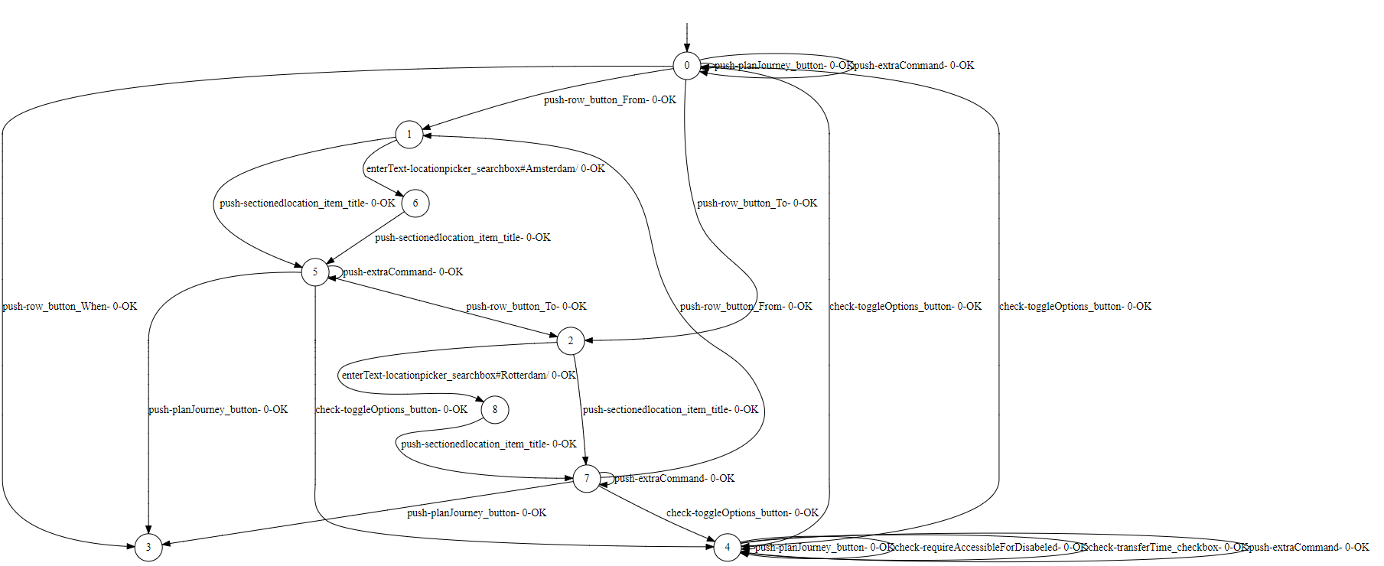
State Machine 9292
3. Mobile State Machine Learning

Slide 13
Vulnerability Detection
Enrich Models
Define Vulnerability Algorithms
OWASP Top10 Mobile
i.e. Insecure Authentication:
Does there exist a path to a node after the login state without traversing the login state?
4. Vulnerability Detection
Notes:
Improper Platform Usage
Insecure Communication
Insecure Authentication
Code Tampering/Extraneous Functionality

Slide 14
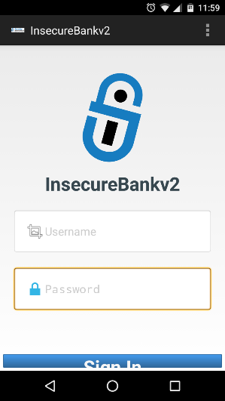
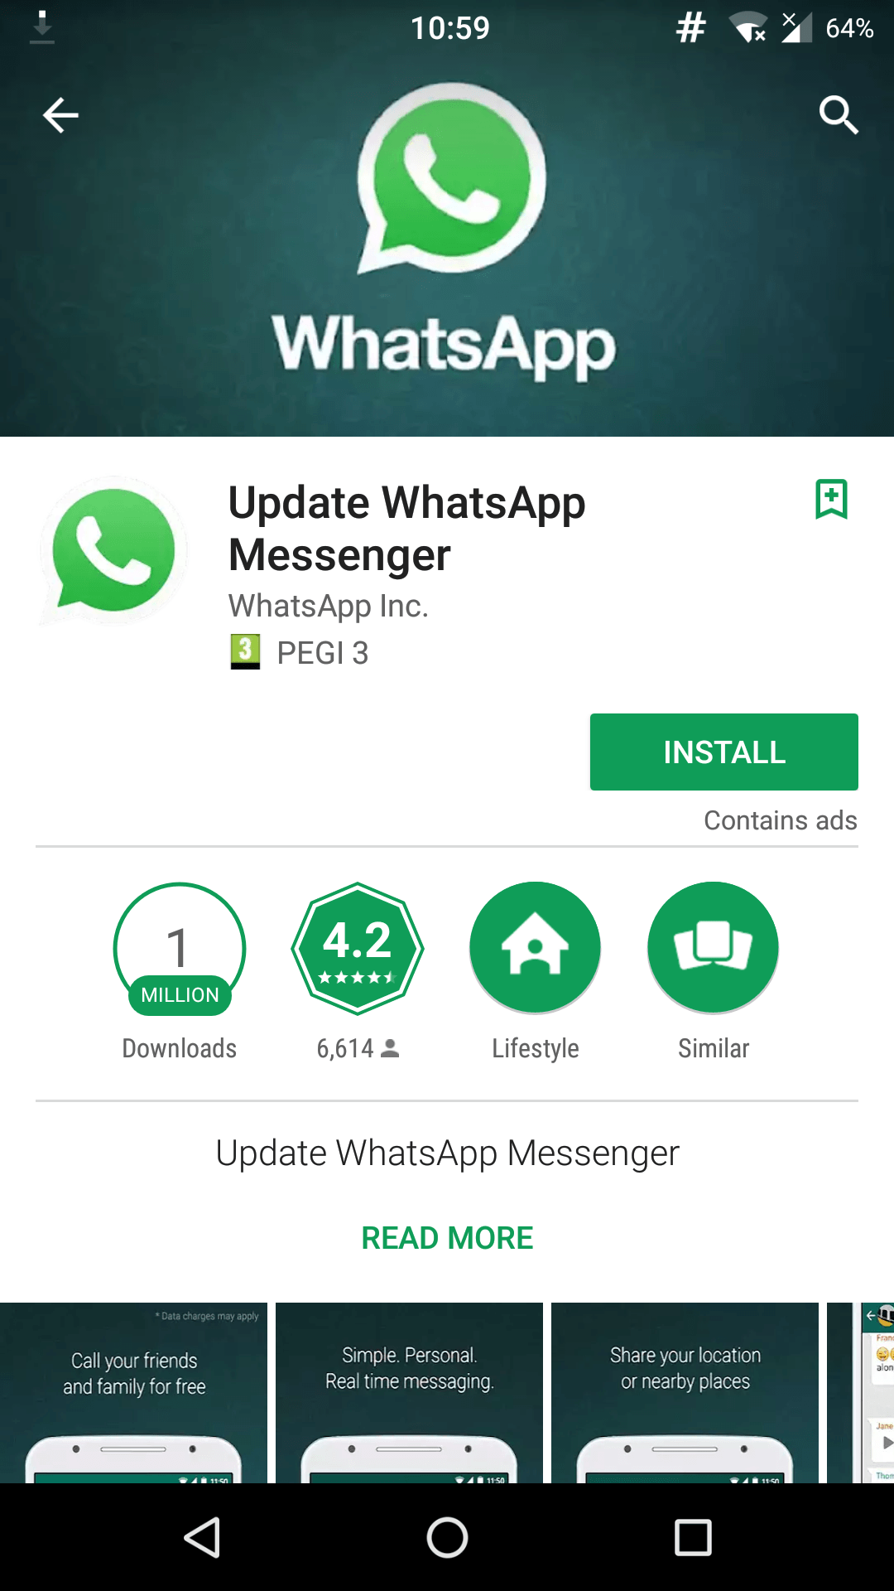
Results
InsecureBankV2
Known Vulnerable App
Fake WhatsApp
Adware
Malware Spreading
4. Results
Notes:
Improper Platform Usage
Insecure Communication
Insecure Authentication
Code Tampering/Extraneous Functionality

Slide 15
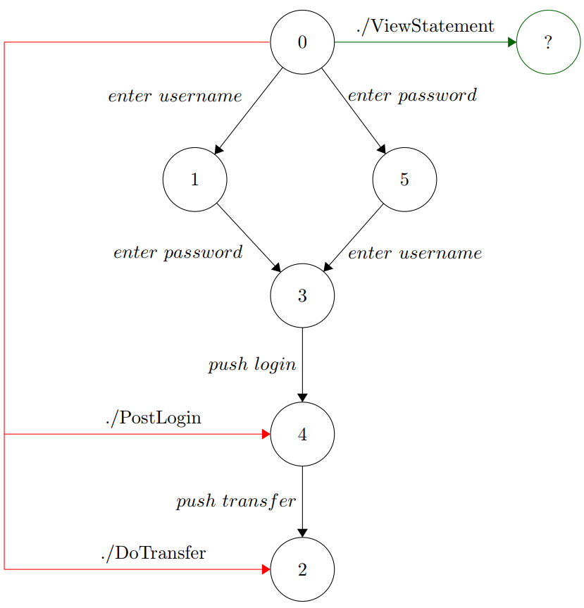
InsecureBankV2
Insecure Authentication
Improper Platform Usage
Insecure Communication
Login
POST http://57.97.2.11:8888/login
4. Results

Slide 16
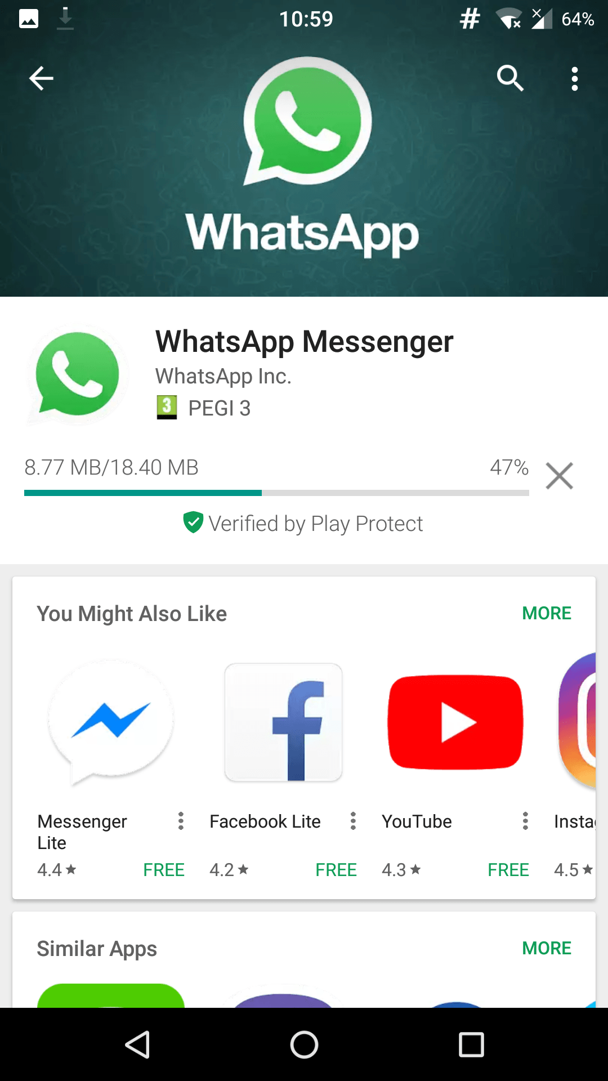
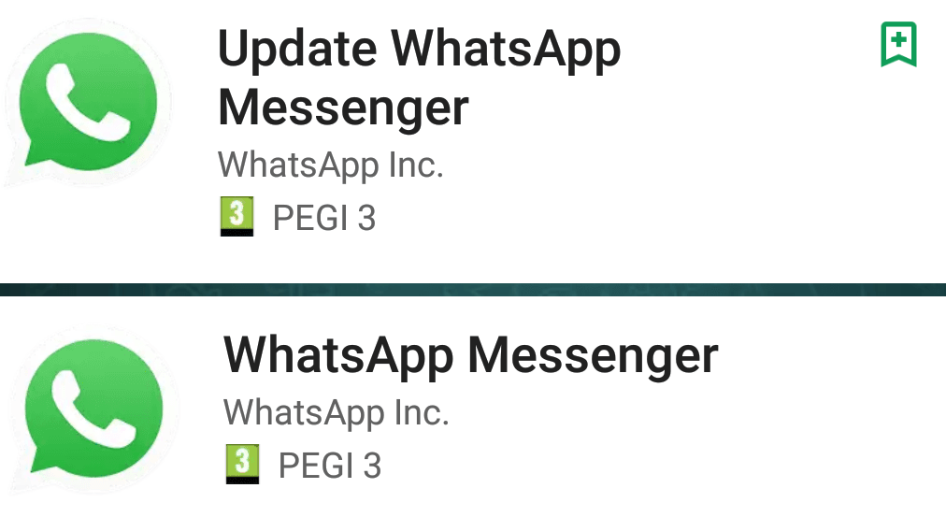
Fake WhatsApp
Background: Unicode trick allows malicious developers to impersonate WhatsApp developers
> 1M downloads, now deleted from Play Store
4. Results

Slide 17
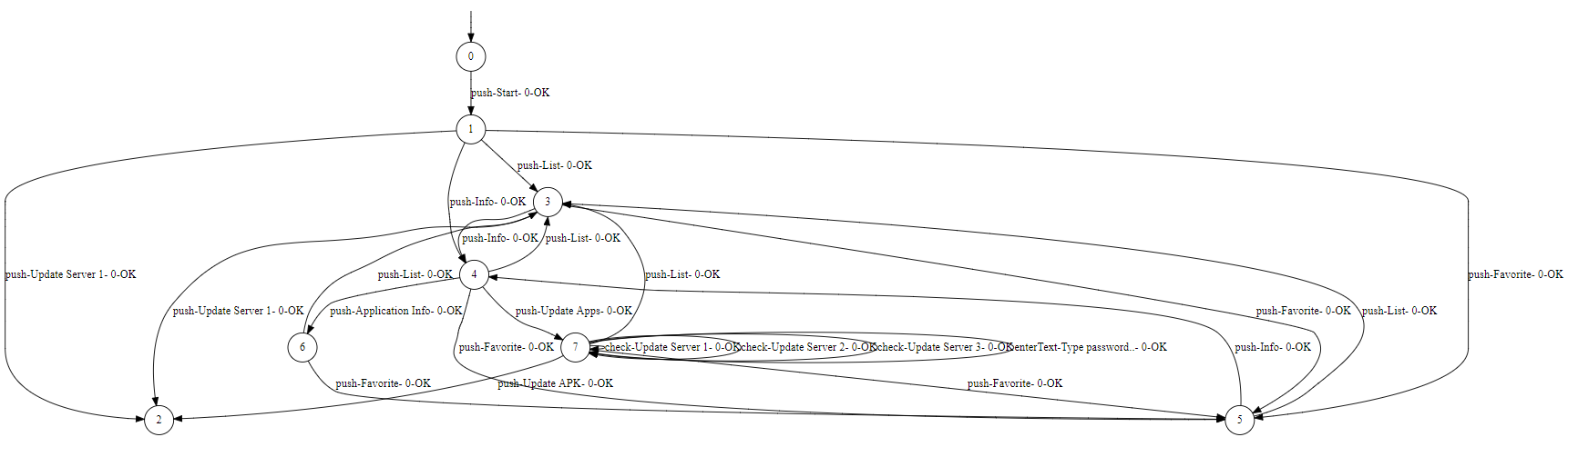
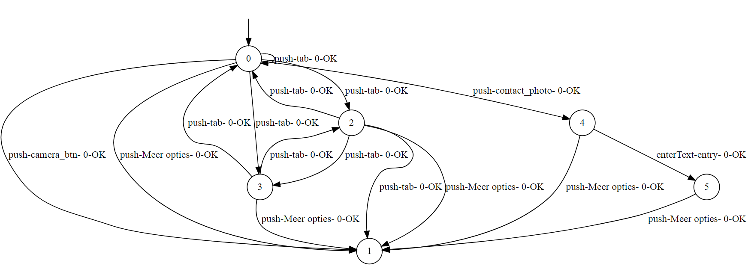
Fake WhatsApp
Malicious
Extraneous Functionality
Access Sequence
State Successor
Alphabet
Insecure Communication
GET http://req.startappservice.com/1.4/..
Benign
4. Results

Slide 18
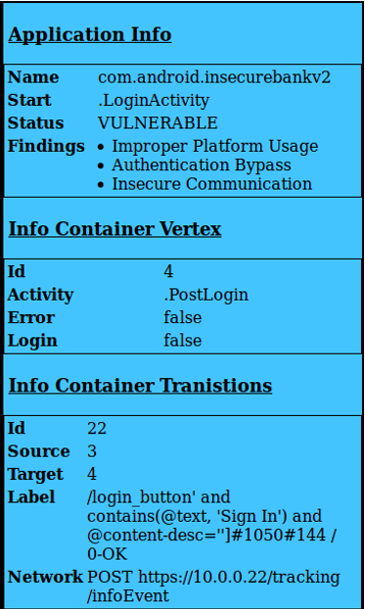
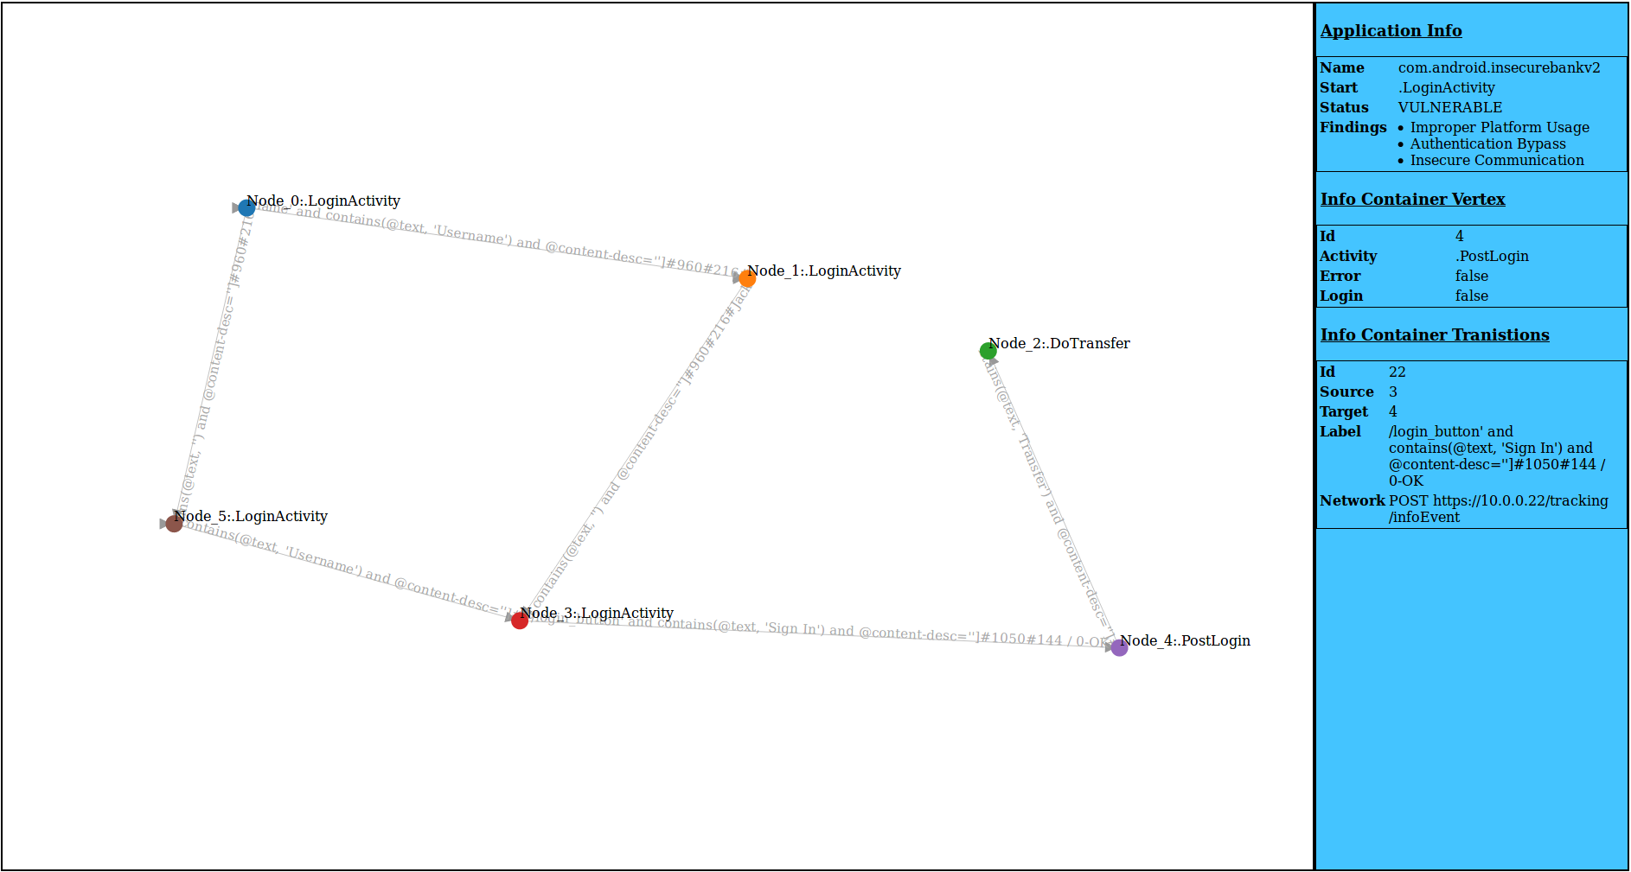
Viewer
4. Results

Slide 19
Conclusion
It is possible to identify weaknesses in mobile Android applications through feasible state machine learning by:
applying modern active learning techniques,
reducing equivalence test space with techniques proposed by Smetsers’ et al. and
enriching models and establishing algorithms that are able to assess the graph.
4. Conclusion
Notes:
Apply TTT algorithm
Apply Smetser’s
Enrich models

Slide 20


Slide 21
Presentation feedback points:
Introduction
Talk more about the insuficciency of current testing tools/methods
State contribution in the Research Goal
Main
Active Learning
Spent more time on introduction of state machines (examples)
Skip second iteration of counterexample
Note about complexity of L*/TTT
Equivalence methods (Chow method, introduce terms)
Chain (linking learning to mobile through appium)
Emphasize the difficulty of learning
Video of the process
Add about mobile indeterminism
Results
Show the complexity of the VulnerableBanking app.
Items: False/Positive Rate
Provide a lookout

